Slide 1
What is Google Drive?

Slide 2
What is Google Drive?
Create multiple different types of files
Easily share these files with others who have a gmail account
Share to view and share to edit
Default is 15 GB of storage-Doane has unlimited GB of storage

Slide 3
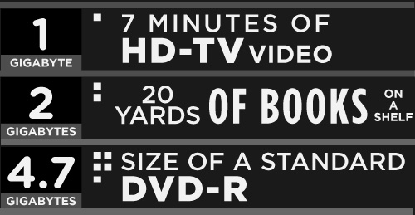
How Much is 15 GB?
With these measurements we can see that 15 GB would equal about 105 minutes of HD-TV video, about 150 yards of books on a shelf, or about 3 standard DVD-Rs.

Slide 4
Types of Files
Documents-similar to Microsoft Word
Spreadsheets-similar to Microsoft Excel
Presentations-similar to Microsoft PowerPoints
Forms-collecting and organizing data

Slide 5
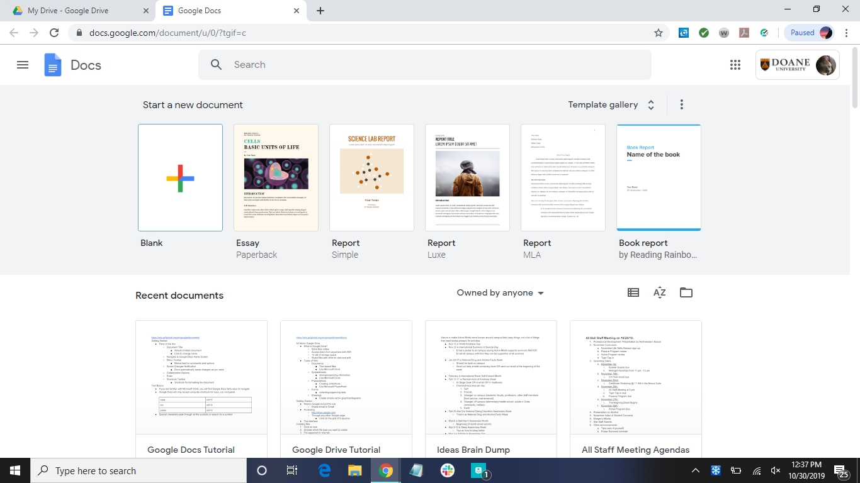

Documents-text-based files; similar to Microsoft Word

Slide 6
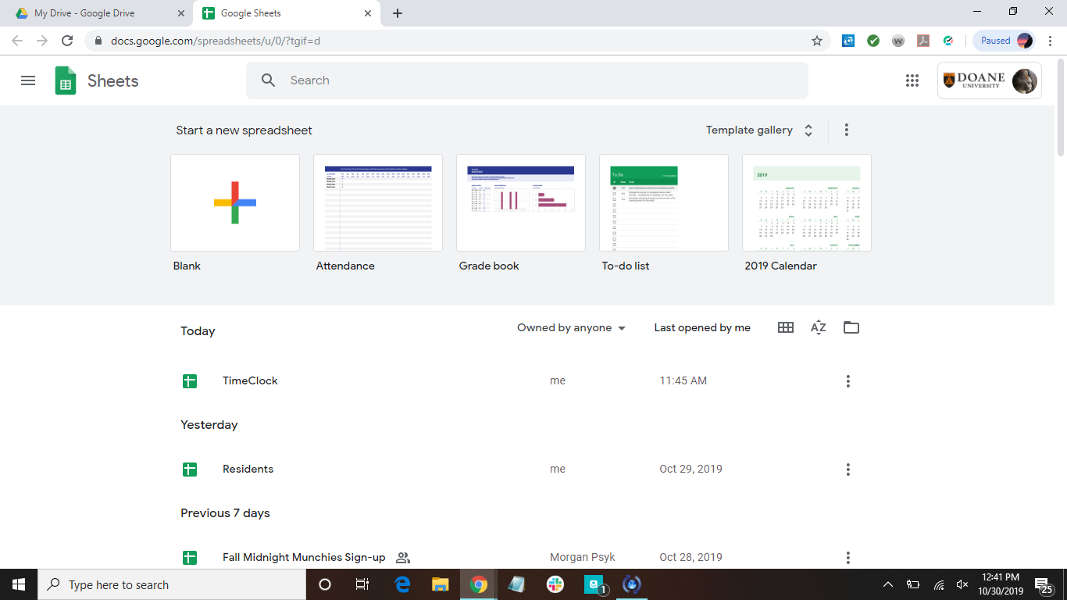
Spreadsheets-storing/organizing information; similar to Microsoft Excel

Slide 7
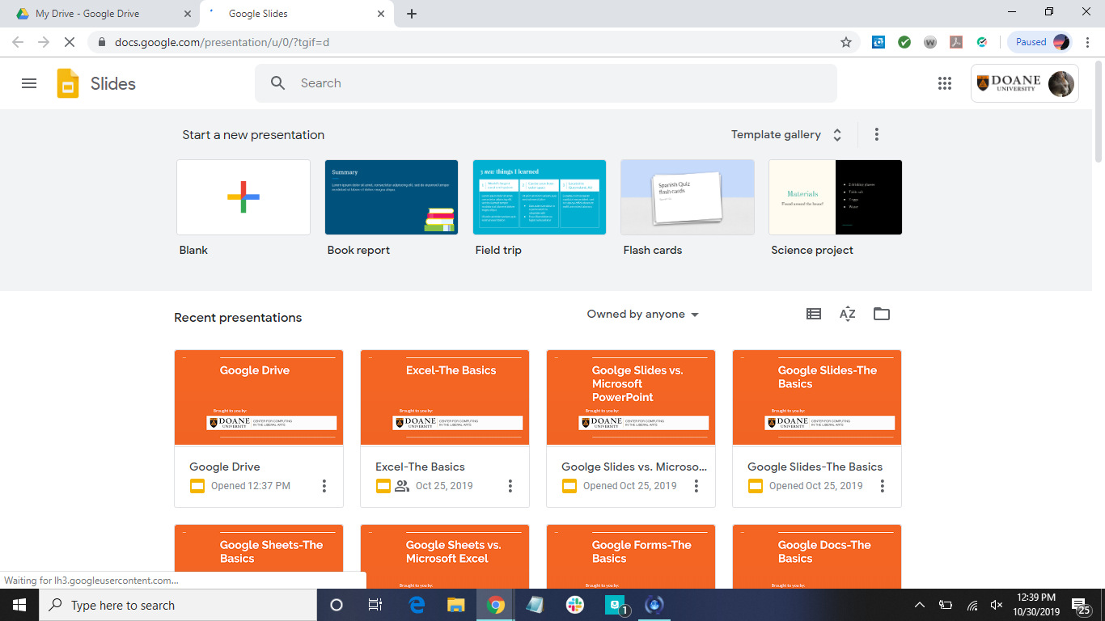

Presentations-creating slideshows; similar to Microsoft PowerPoint

Slide 8
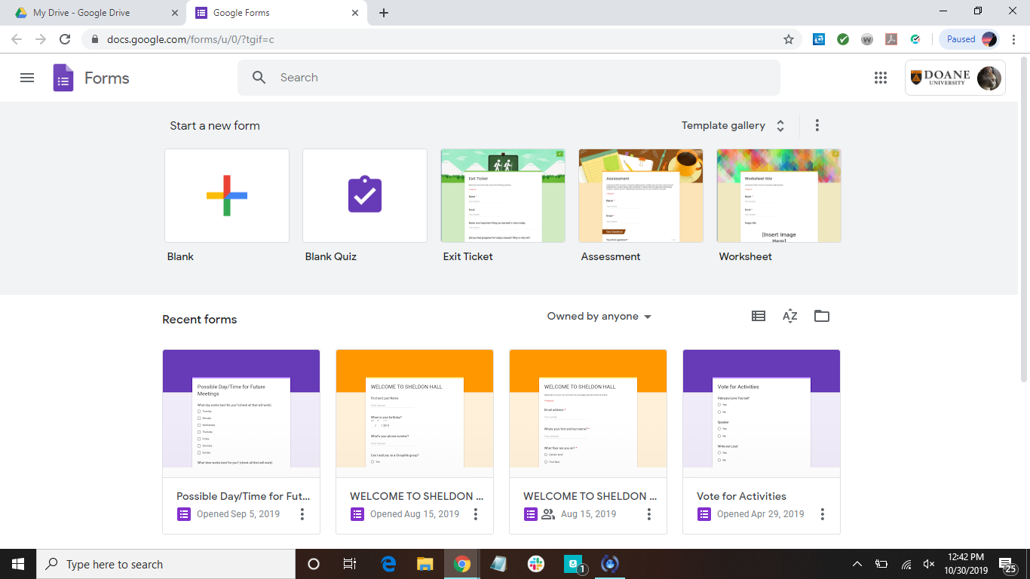
Forms-collecting/organizing data

Slide 9
Getting Started
Need a Google account to use
Doane email is a Google account
Accessing Google Drive
http://drive.google.com
Through any other Google page
Click on the grid of 9 squares in the top right corner of any Google page

Slide 10
How To Create a New File
Log in to Google Drive
Click on New
Choose what type of file you would like
Rename the file so you can find it again

Slide 11
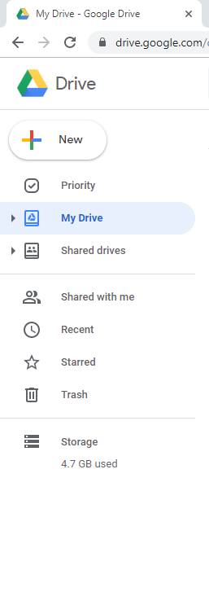
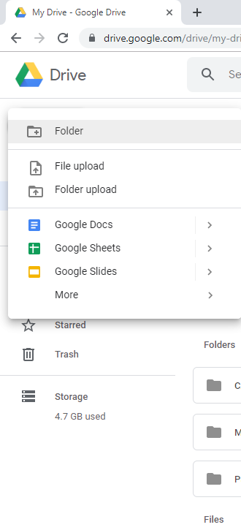
Click here…
...choose here…

Slide 12
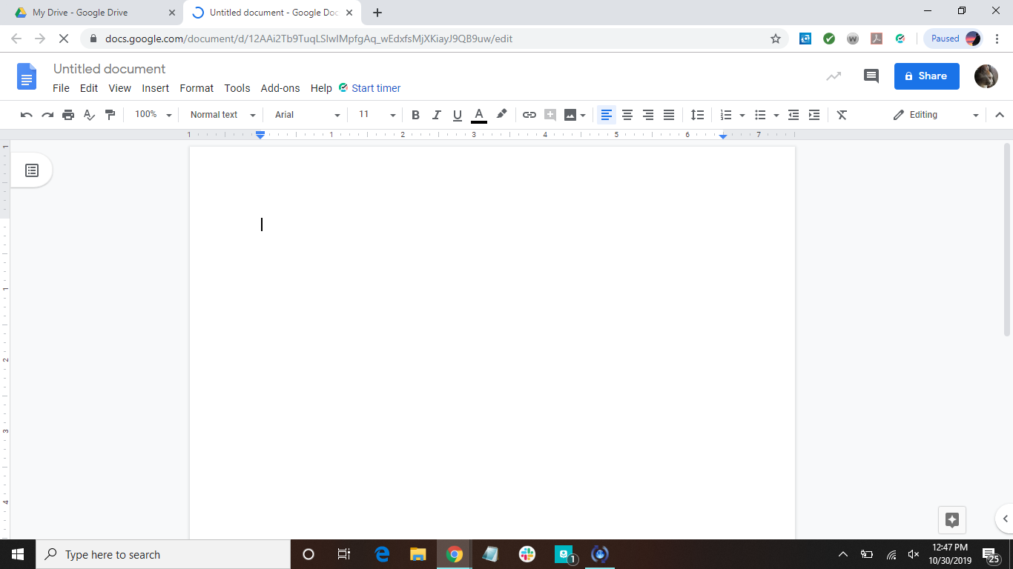
… then the file should appear in a new tab
Click and rename the file so you can find it later

Slide 13
How To Upload a File to Drive
Click and hold on the file you want to upload, and drag into your Drive
OR
Click on New
Click on File Upload
Search for the file you want to upload

Slide 14
Click here…
… then here…

Slide 15
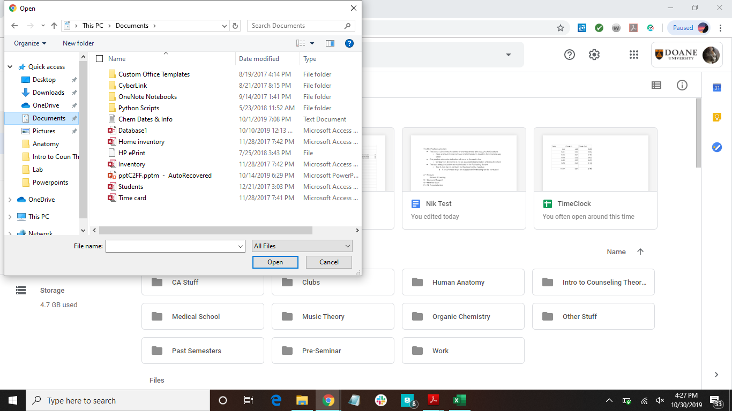
Find the file
Click on file, then click on Open

Slide 16
Converting a File to Google’s Format
Click on the uploaded file you want to edit
A preview of the file will appear
Up at the in the center, click on “Open File”
The file will then be automatically converted to a Google file that matches and can be edited

Slide 17
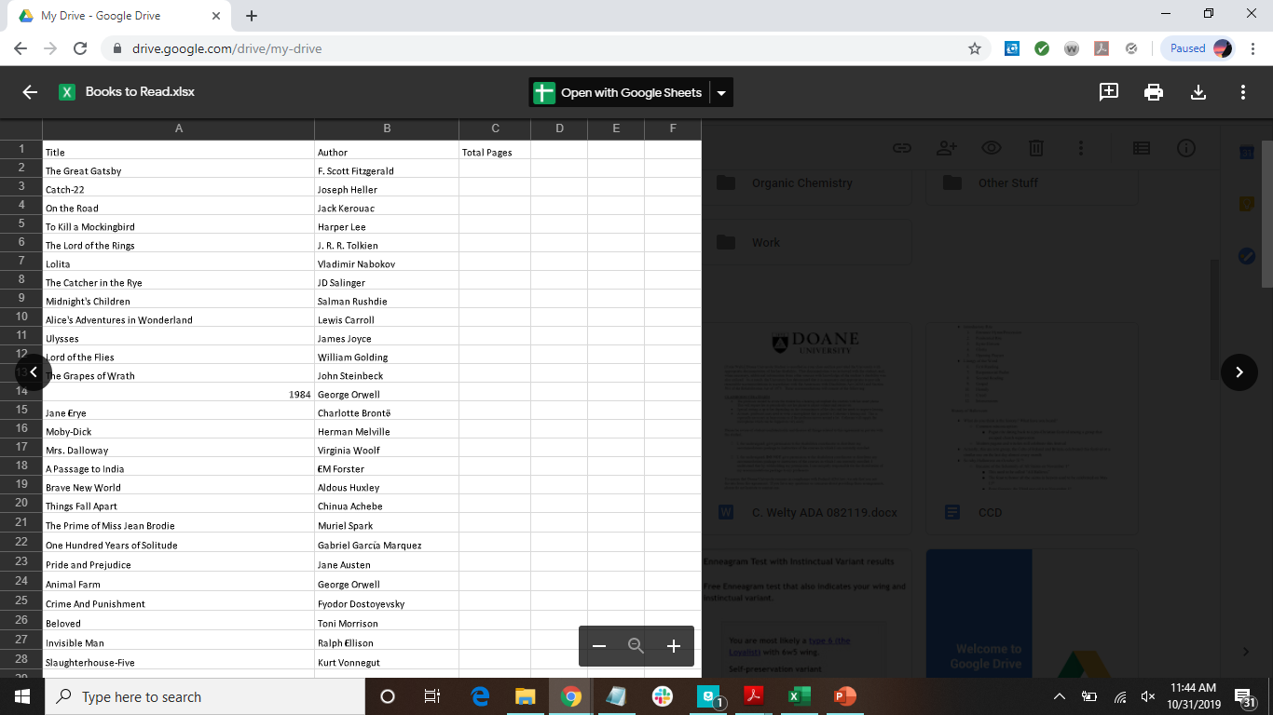
Click here

Slide 18
How to Create a Folder
Click on New
Click on Folder
Type in a name for the folder
Click on Create
To move files into a folder:
Click and drag the file into the folder

Slide 19
Click here…
...choose here…

Slide 20
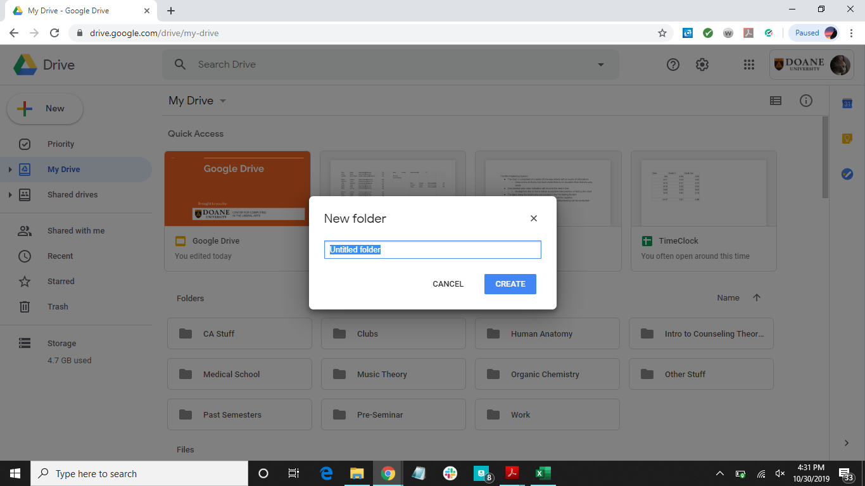
Rename folder and click Create

Slide 21
How to Delete Files
Right click on the file
Click on Remove

Slide 22
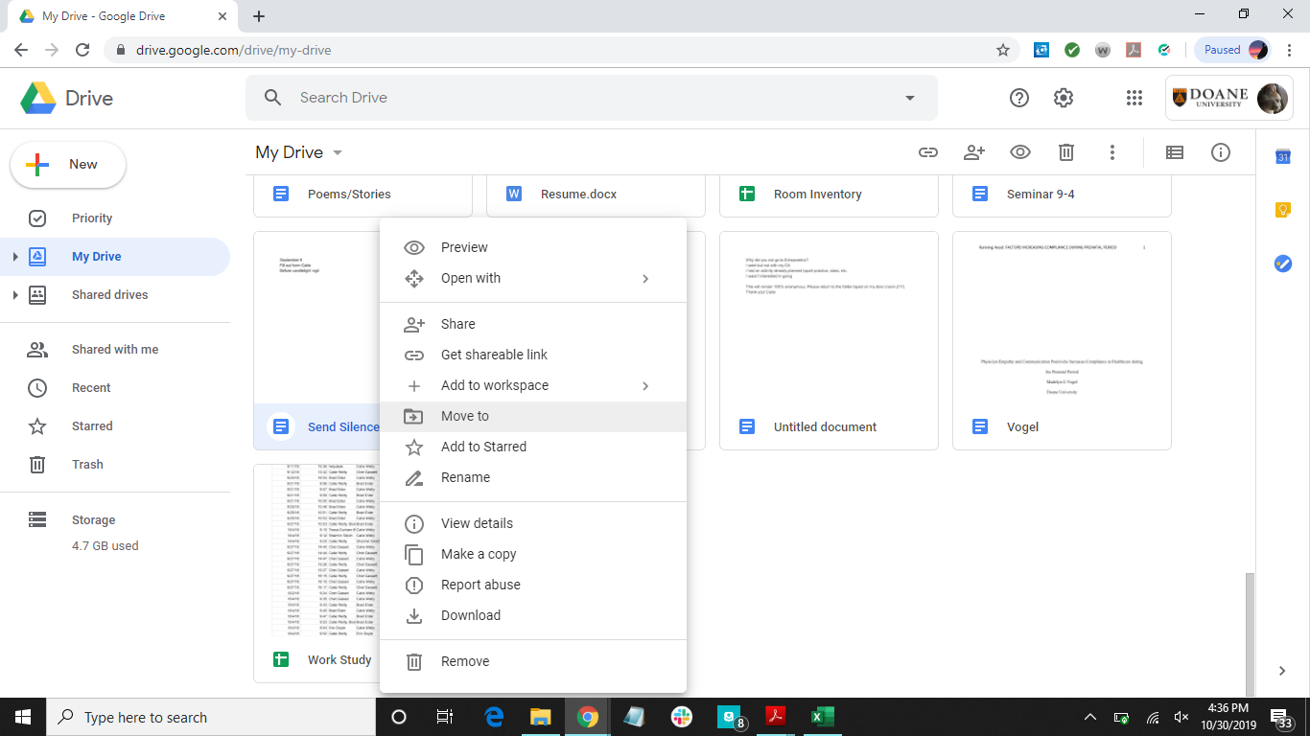
Click here

Slide 23
How to Share Files (version 1)
Select the file you want to share
Click the share button
Type in the emails of the people you want to share the file with
Can add a message if you would like
Can decide the level of editing power you give to the people
Edit
Comment on
View
Click Send
Why share files?
Real-time collaboration the same file

Slide 24
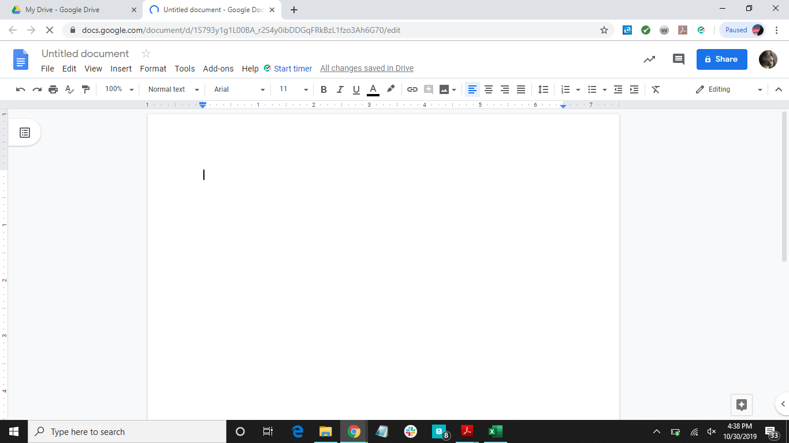
Click here

Slide 25
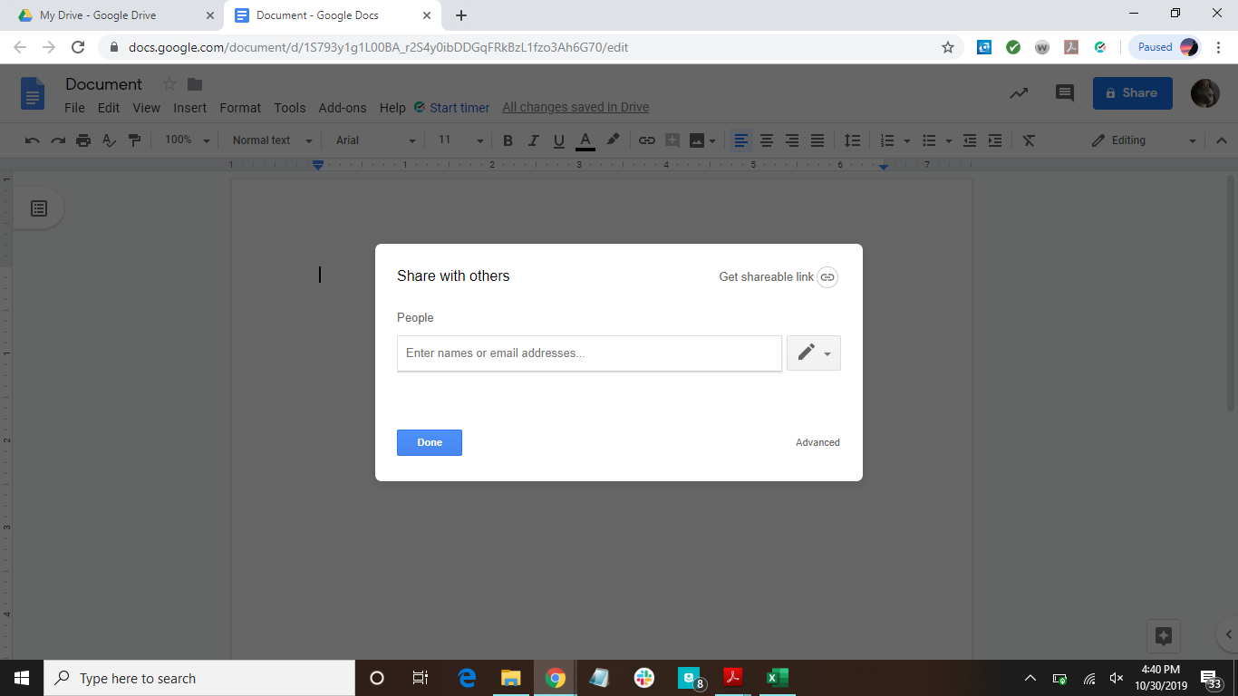
Click here to choose viewing settings
Type in emails of those you want to share with

Slide 26
How to Share Files (version 2)
Select the file you want to share
Click the share button
Click “Get shareable link”
Copy link and paste it in an email or on a web page

Slide 27
Click here

Slide 28
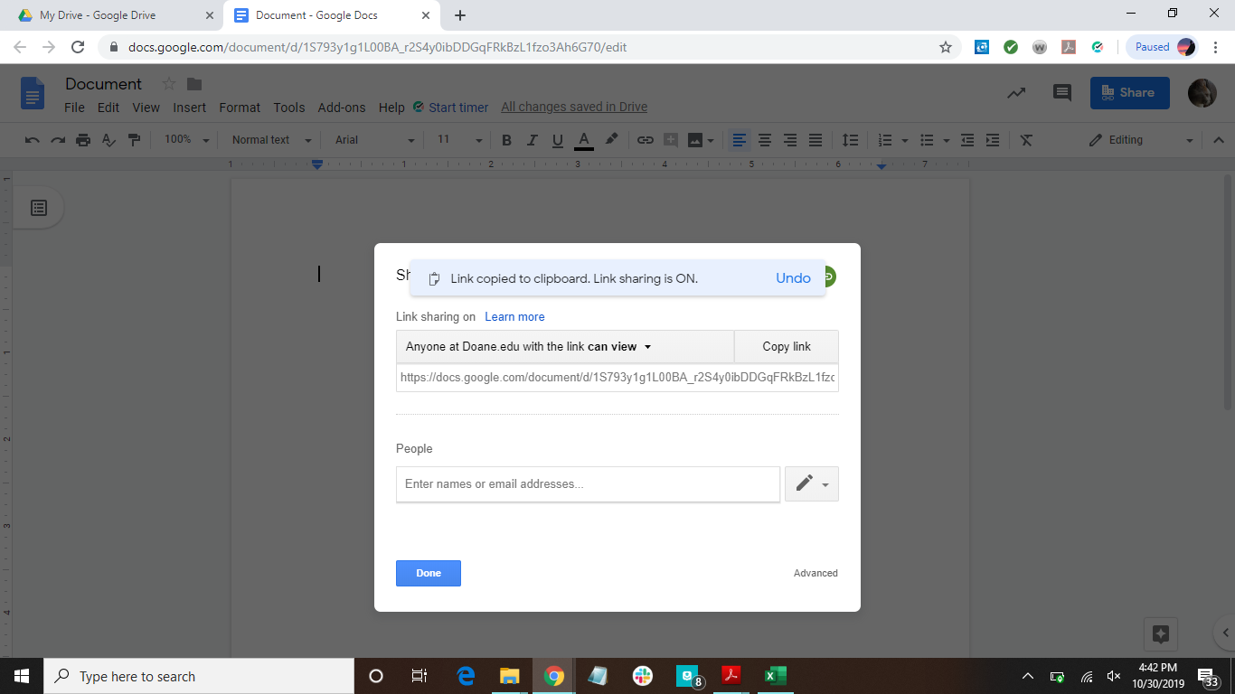

Slide 29
How To View Files That Have Been Shared With You
Click in the tab titled “Shared with me”
Locate the file
Click on the file
Click on “Add to My Drive”

Slide 30
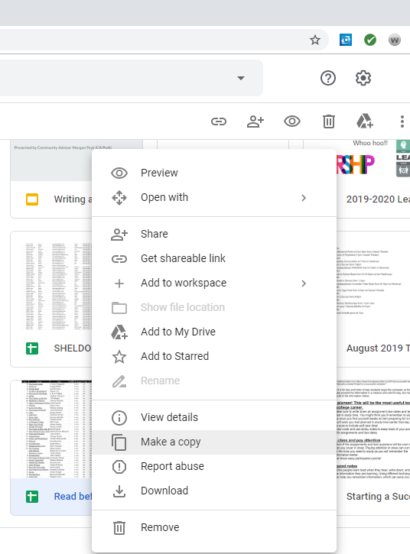
Click here…
… then here

Slide 31
How To Download a File
Right-click on the file
Click on Download

Slide 32
Click here

Slide 33
How To Print a File
Open file
Click on File
Click on Print

Slide 34
Click here OR….
2. … click here…

Slide 35

… and then click here

Slide 36
Have more questions?
Email us at ccla@doane.edu or come visit us in Communications 188D from 9am to 5pm.
You can also visit our website at https://www.doane.edu/ccla

Slide 37
References
GCFLearnFree.org. Google Drive and Docs. Retrieved from https://edu.gcfglobal.org/en/googledriveanddocs/
Lee, J. (2012, August 14). Memory Sizes Explained: Gigabytes, Terabytes, and Petabytes in Context. Retrieved from https://www.makeuseof.com/tag/memory-sizes-gigabytes-terabytes-petabytes/

Slide 38

Please provide some feedback on the presentation by following the QR Code below.

